Slide 1
Chapter Three: The Data Link Layer

Slide 2
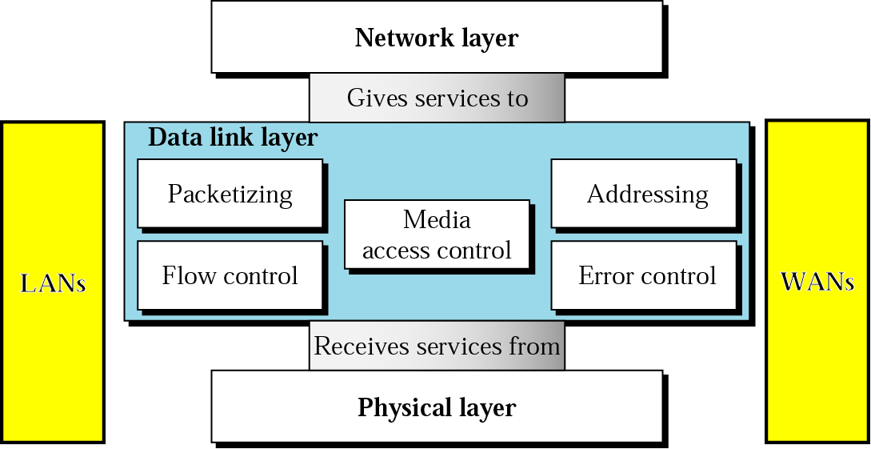
Introduction
the data link layer is responsible for carrying a packet from one hop (computer or router) to the next hop; i.e., it has local responsibility unlike the network layer
position of the data link layer

Slide 3
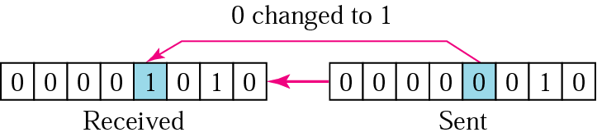
3.1 Error Detection and Correction
mainly a data link layer function
networks must be able to transfer data from one device to another with complete accuracy - our wish
data can be corrupted during transmission - many factors exist - like transmission impairments
hence, reliable systems must have a mechanism for detecting and correcting errors
two types of errors: single-bit and burst
single-bit error: only one bit in a data unit (byte, character, packet, ...) has changed; less likely to occur in serial transmission (since noise normally lasts longer than the transmission time of 1 bit, e.g. 1 microsecond if speed is 1 Mbps), but most likely to occur in parallel transmission

Slide 4
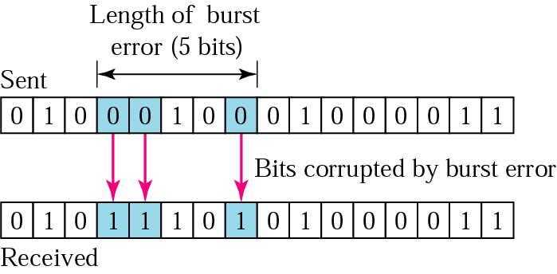
burst error: 2 or more bits in the data unit have changed; most likely to occur in serial transmissions
error detection and correction: include redundant error-detection (and correction) codes with the data
two possibilities
include enough redundant information (called error-correcting codes) to enable the receiver to deduce what the transmitted data must have been; this method is often referred to as forward error correction; applicable on unreliable channels such as wireless links
include only enough redundant information (called error-detecting codes) to allow the receiver to deduce that an error occurred, but not which error, and have it request retransmission; applicable on reliable channels such as fiber

Slide 5
error-detecting codes: two types: parity check and cyclic redundancy check (a third one, called checksum, also exists)
parity check: most common and simple; two varieties
simple parity check: a redundant bit, called a parity bit, is added to every data unit so that the total number of 1s in the unit (including the parity bit) becomes even (or odd for odd-parity)
this method can detect all single-bit errors; it can detect burst errors only if the total number of errors in each data unit is odd
two-dimensional parity check: a block of bits is organized in a table (rows and columns)

Slide 6
original data
1100111 1011101 0111001 0101001
1 1 0 0 1 1 1 1
1 0 1 1 1 0 1 1
0 1 1 1 0 0 1 0
0 1 0 1 0 0 1 1
0 1 0 1 0 1 0 1
data and parity bits
11001111 10111011 01110010 01010011 01010101
can detect most errors
if 2 bits in one data unit are damaged and two bits in exactly the same positions in another data unit are also damaged, the checker will not detect an error
row parities
column parities
more overhead

Slide 7
cyclic redundancy check (CRC): is based on binary division
the CRC is appended to the end of a data unit so that the resulting data unit becomes exactly divisible by a second, predetermined binary number
read about the method of generating the CRC
error correction: two methods
error correction by retransmission: when an error is detected, the receiver will tell the sender to retransmit the entire data unit; see next: Data Link Control
forward error correction: the receiver can use an error-correcting code to correct certain errors; the hamming code is used to detect and correct errors; ☺

Slide 8
3.2 Data Link Control and Protocols
for reliable data delivery across the link, the data link layer has two most important responsibilities: flow control and error control, collectively known as data link control
Flow Control
refers to a set of procedures used to restrict the amount of data that the sender can send before receiving an acknowledgement
it is an end-to-end mechanism for regulating traffic between source and destination
congestion control: a mechanism used by the network to limit congestion
flow control and congestion control are not really separable, and we will refer to both as flow control

Slide 9
limiting factors: speed of the receiver (to process incoming data), amount of memory (buffer) to store the incoming data before processed, and network capacity
rate of processing is normally slower than rate of transmission
the receiver must be able to inform the sender to temporarily halt transmission until it is ready to receive more
if no flow control
when overload occurs
queues build up
packets are discarded
sources retransmit messages
congestion increases ➔ instability
flow control prevents network instability by keeping packets waiting outside the network rather than in queues inside the network
avoids wasting network resources

Slide 10
Error Control
refers to both error detection and error correction
in the data link layer, error control refers primarily to methods of error detection and retransmission
anytime an error is detected, specified frames are retransmitted; this process is called automatic repeat request (ARQ)
Flow and Error Control Mechanisms (three methods)
An Unrestricted Simplex Protocol
simplex transmission: from sender to receiver
processing time ignored; the receiver is assumed to process the received data infinitely quickly
infinite buffer space assumed to be available
communication channel assumed to be free of error

Slide 11
Stop-And-Wait ARQ
protocols in which the sender sends one frame and then waits for an acknowledgement before proceeding are called stop-and-wait
data traffic is simplex, but frames travel in both directions; hence a half-duplex physical channel suffices
this protocol fails if ack frames by the receiver do not arrive or are late; the sender may time-out and send a frame again creating duplicate frames; the solution is to give sequence numbers to data frames and acks
there are four situations: normal operation, the frame is lost, the ack is lost, the ack is delayed

Slide 12
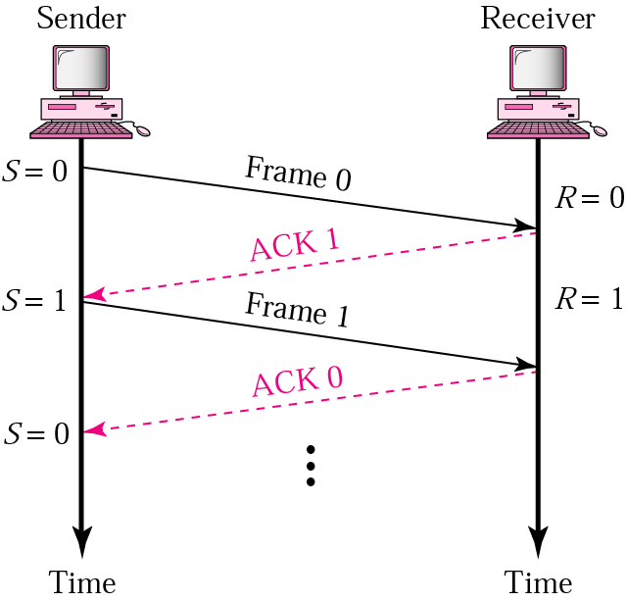
Normal operation

Slide 13
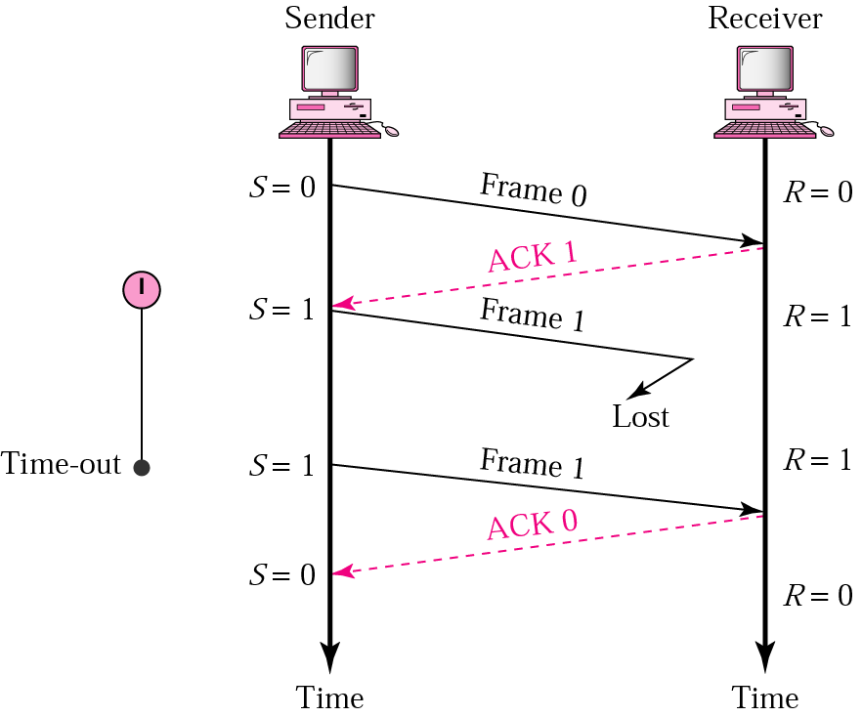
Lost frame

Slide 14
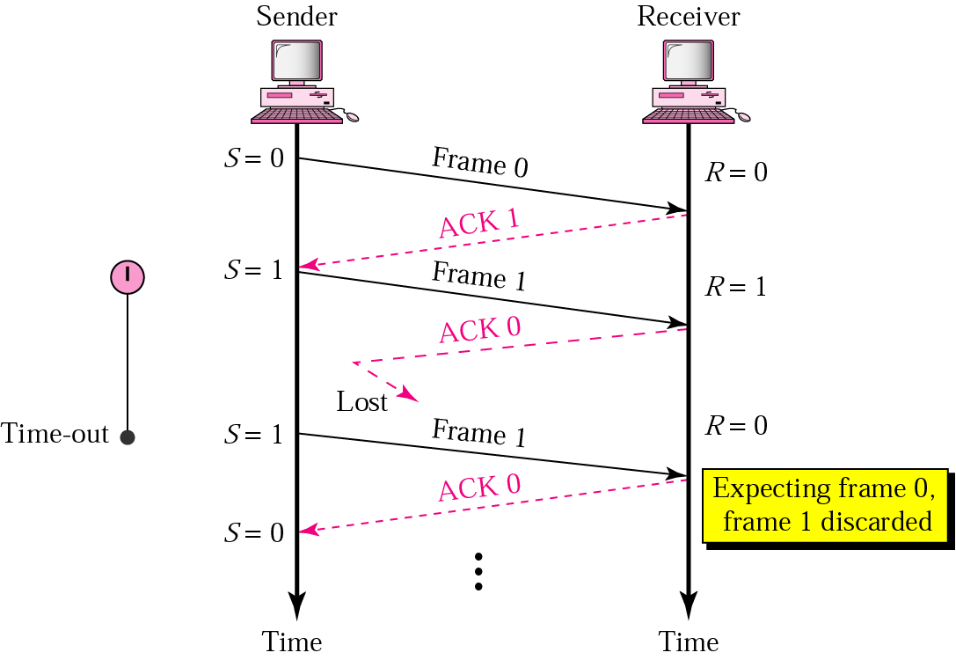
Lost ack

Slide 15
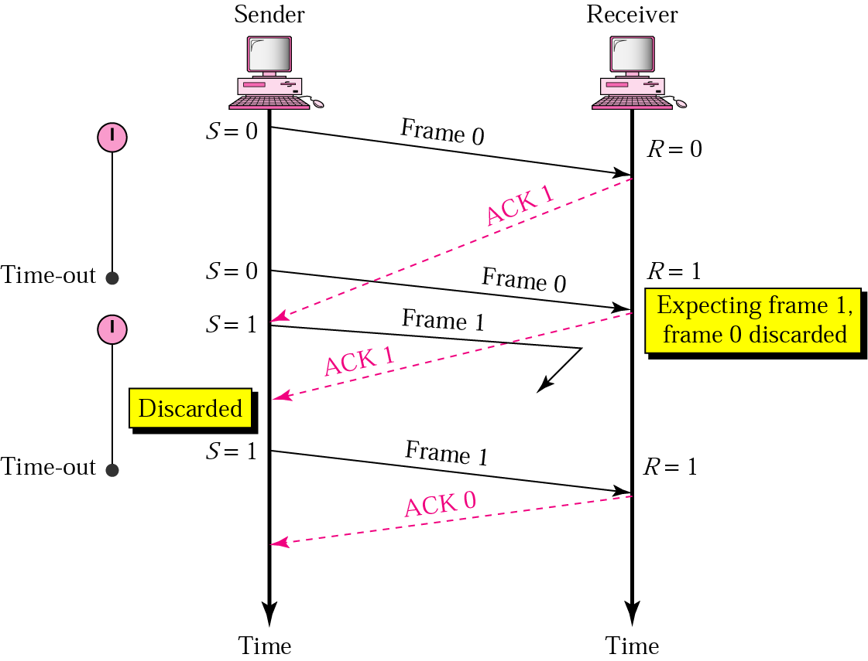
Delayed ack

Slide 16
Sliding Window Protocols
Stop-and-wait ARQ is not efficient; there is only one frame that is sent
can we transmit multiple frames while waiting for an ack?
use full-duplex transmission
two protocols: Go-Back-N ARQ and Selective Repeat ARQ
both methods require frames to be numbered
sequence numbers
frames from a sending station are numbered sequentially from 0 to 2^{m}-1, where m is the number of bits of the sequence number in the frame header
e.g., let m = 3, then frames can be numbered as
0, 1, 2, 3 ,4, 5, 6, 7, 0, 1, 2, 3, 4, 5, 6, 7, 0, 1, …

Slide 17
Go-Back-N-ARQ
the sender and receiver have sliding windows
the sender’s window is of fixed size and is at most 2^{m}-1; but other protocols such as TCP allow variable size windows (see later in the transport layer); it holds frames sent but not acknowledged
the receiver’s window is of size 1
the sender sets a timer for each frame sent; the receiver has no timer
the receiver sends positive acknowledgements if a frame has arrived safe and in order
if a frame is damaged or out of order, the receiver discards it and keeps silent and discards all subsequent frames; this causes the timer of the sender to expire and goes back and resends all frames, beginning from the one with the expired timer
the receiver does not need to acknowledge frames individually

Slide 18
Sender sliding window

Slide 19
Receiver sliding window

Slide 20
Why is the sender’s window < 2^{m}?
To detect repeated frames
Let m = 2
If the size of the window is 3 (2^{m}-1) and all the 3 acks are lost, the timer for frame 0 expires and all frames are resent; the window of the receiver is expecting frame 3 not frame 0; so it will discard the duplicated frame
If the size of the window is 4 (2^{m}) and all the 4 acks are lost, the sender will send the duplicate of frame 0; since the window of the receiver is expecting frame 0, it accepts it not as a duplicate but as the first frame in the next cycle

Slide 21
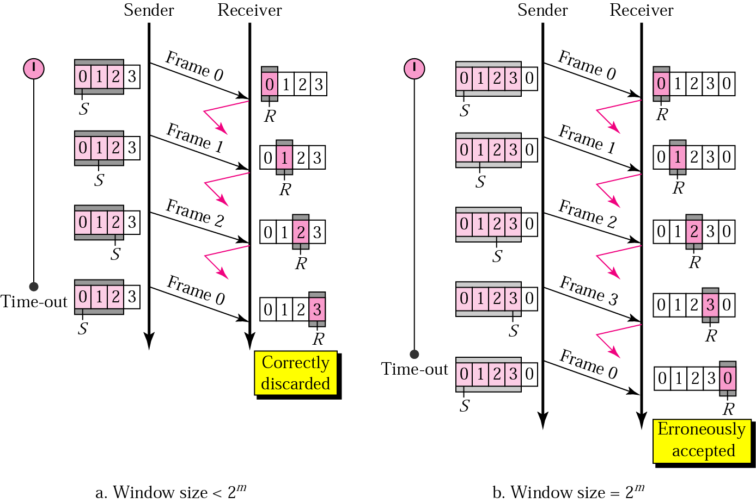

Slide 22
Selective Repeat ARQ
in GO-Back-N ARQ, the task of the receiver is simplified; no need to buffer out-of-order frames; they are simply discarded
this protocol is inefficient for a noisy link that has a high probability of damage resulting in the resending of multiple frames
for a noisy link, use Selective Repeat ARQ that requires resending only the damaged frame
Selective Repeat ARQ defines a negative ack (NAK) that reports the sequence number of a damaged frame before the timer expires
the sender and receiver windows are both at most half of 2^{m}
the receiver's window defines the range of acceptable sequence numbers, i.e., frames may arrive out of order

Slide 23
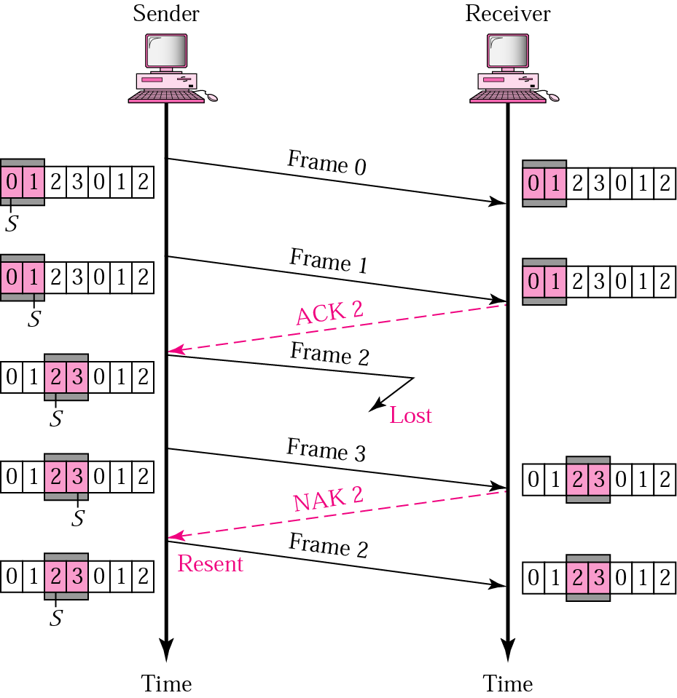
Let m = 2; window sizes = 2

Slide 24
Why are the sender and receiver windows at most half of 2^{m}?
To detect repeated frames
Let m = 2
If the size of the window is 2 and both acks are lost, the timer for frame 0 expires and frame 0 is sent; the window of the receiver is expecting frame 2 not frame 0; so it will discard the duplicated frame
If the size of the window is 3 and all the 3 acks are lost, the sender sends a duplicate of frame 0; since the window of the receiver is expecting frame 0 (frame 0 is part of the window), it accepts it not as a duplicate but as the first frame in the next cycle

Slide 26
examples of data link protocols
HDLC - High-level Data Link Control
an ISO standard
an actual protocol designed to support both half-duplex and full-duplex communication over point-to-point and multipoint links that implements the ARQ mechanisms
PPP - Point-to-Point Protocol
used in the Internet for router-to-router and home user-to-ISP traffic

Slide 27
3.3 Medium Access Control
The MAC Sublayer: in a network, two devices can be connected by a dedicated link (like a reserved highway, may be on certain occasions!) or a shared link (like a public highway)
point-to-point access: when two devices are connected by a dedicated link and this link can be used by them at any time; PPP is used
multiple access: when two devices are connected by a shared link; when two devices in a multiple access situation get access to the link or a channel in the link, they may need to use a point-to-point access protocol to exchange data
Multiple Access Protocols
the problem of controlling the access to the medium is similar to the rules of speaking in an assembly (the right to speak is upheld; two people do not speak at the same time; do not interrupt each other; do not monopolize the discussion; ...)

Slide 28
three categories of multiple access protocols
Random Access Protocols - try your best like taxis do
MA - Multiple Access
CSMA - Carrier Sense MA
CSMA/CD - CSMA with Collision Detection
CSMA/CA - CSMA with Collision Avoidance
Controlled-Access Protocols - get permission
Reservation
Polling
Token Passing
Channelization Protocols - simultaneous use
FDMA - Frequency-Division MA
TDMA - Time-Division MA
CDMA - Code-Division MA

Slide 29
Random Access Protocols
each station has the right to use the medium without being controlled by any other station
collision may occur if more than one station tries to send
we need a procedure to answer the following questions
when can a station access the medium?
what can the station do if the medium is busy?
how can the station determine the success or failure of the transmission?
what can the station do if there is an access conflict?
MA - Multiple Access
ALOHA is the earliest RA method developed at the University of Hawaii in the early 1970s
originally designed to be used on a radio LAN with a data rate of 9600 bps
can also be used in satellite and wireless transmissions
Aloha (in Hawaiian language) means hello and goodbye

Slide 30
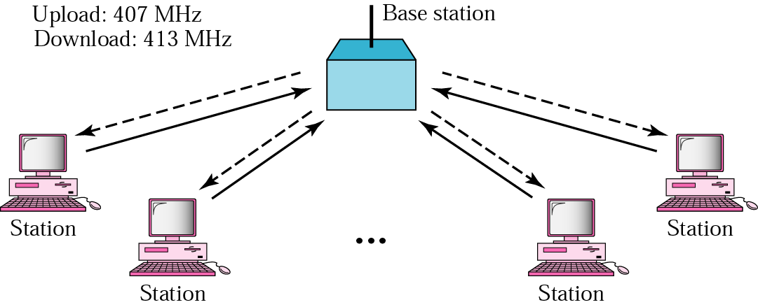
a base station serves as a central controller; each station sends a frame to the base station with an uploading frequency of 407 MHz (the solid line in the figure); the base station sends it to the receiver using a downloading frequency of 413 MHz (the dashed line in the figure);

Slide 31
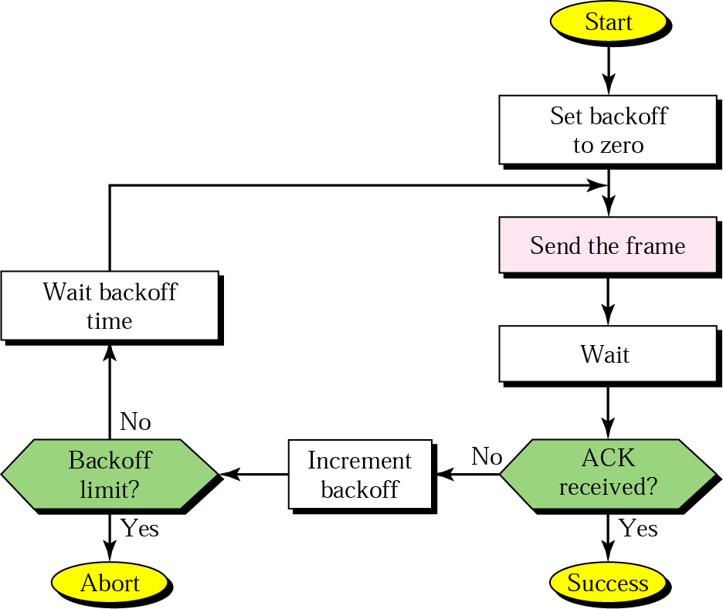
potential collisions exist (on the upload link); so wait for acknowledgement; if none arrives wait a period of time (2 times the maximum propagation delay), send again if back off limit did not reach; the time it waits increases from one trial to the next

Slide 32
versions
pure ALOHA
slotted ALOHA
time is divided into discrete intervals of one packet duration
transmitting a frame is allowed only at the beginning of a slot
still collision is possible; collided packet are retransmitted after a random delay

Slide 33
CSMA - Carrier Sense MA - polite version of ALOHA
to minimize the chance of collision, each station first listens to the medium before sending; “listen before talk”
if the channel is busy, it waits until it is idle
otherwise it transmits; if a collision occurs, it waits a random amount of time and starts listening again
the chance of collision is minimized
but may still occur because of the propagation delay (a station doesn’t know if another one has just started transmitting) or
if two or more stations start transmitting at the same time

Slide 34
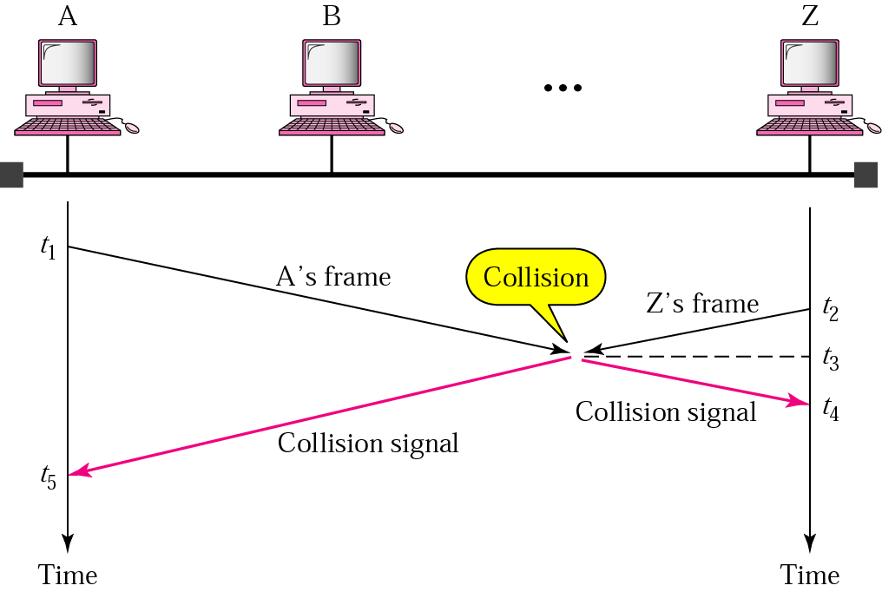
t₁ < t₂ < t₃ < t₄ < t₅

Slide 35
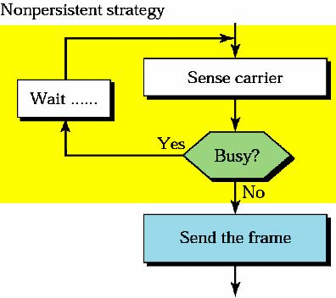
persistence strategies: two substrategies have been defined
nonpersistent: sense a line and send if it is idle; otherwise wait a random amount of time before listening (hence less greedy than continuously listening); reduces the chance of collision, but also reduces the efficiency of the network and has longer delays

Slide 36
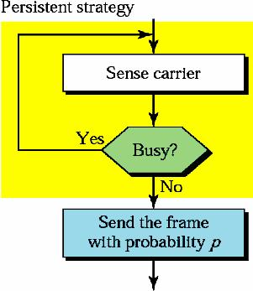
persistent: sense a line and “send” if it is idle; otherwise listen; two variations of sending
1-persistent: if the line is idle, send immediately (with probability 1)
p-persistent: if the line is idle, send with probability p and refrain from sending with probability 1-p; if p = 0.2, then a station sends 20% of the time that a line is idle, and refrains from sending 80% of the time
implementation: the station generates a random number between 1 and 100; if it is < 20, then it sends, otherwise it refrains
it reduces the chance of collision and improves efficiency; depends on the value of p (see next figure)

Slide 37
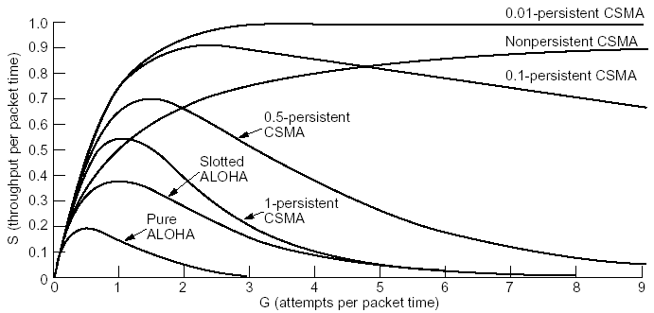
computed throughput versus offered traffic for the protocols discussed so far

Slide 38
CSMA/CD - CSMA with Collision Detection
adds a procedure to handle a collision
if a collision is detected and to reduce the probability of collision the second time, the sender waits; it has to back off
it waits a little the first time, more if a collision occurs again, much more if it happens a third time, and so on; finally gives up
in the exponential backoff method, it waits an amount of time between 0 and 2^{N} x maximum_propagation_time, where N is the number of attempted transmissions
line sensing is done using one of the persistent strategies

Slide 39
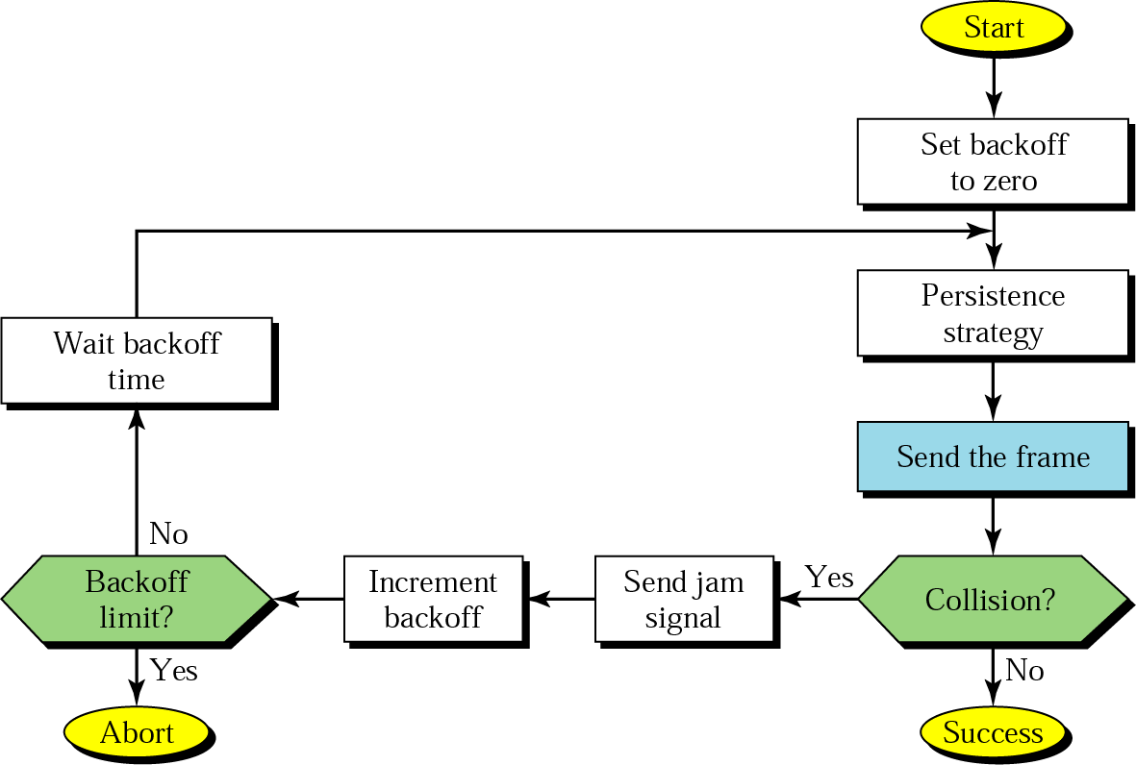
sending a jam alerts the other stations and also to discard the part of the frame received
used in traditional Ethernet; CSMA was never implemented

Slide 40
CSMA/CA - CSMA with Collision Avoidance
avoids collision
uses one of the persistence strategies; after it finds the line idle, it waits an IFG (interframe gap) amount of time; it then waits another random amount of time; after that it sends the frame and sets a timer;
if it receives an ack before the timer expires, the transmission is successful; otherwise something is wrong (the frame or the ack is lost); waits for a backoff amount of time and re-senses the line
used in wireless LANs

Slide 41
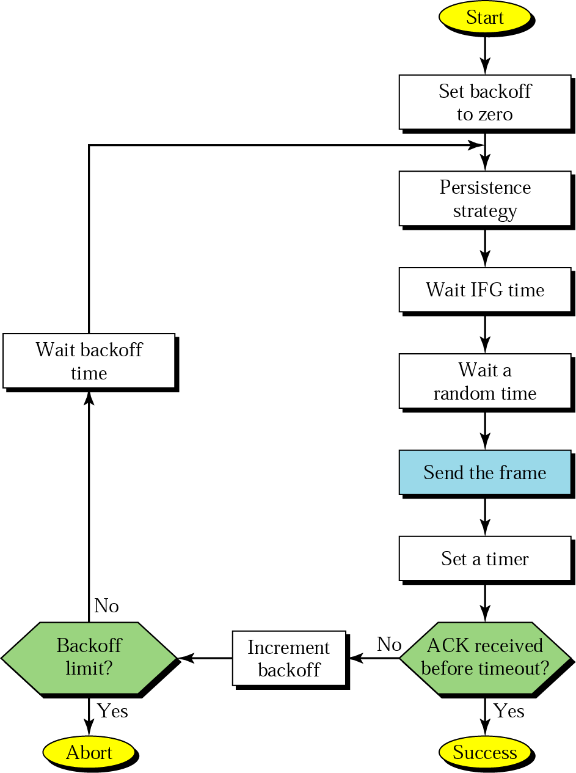
the frame or the ack is lost

Slide 42
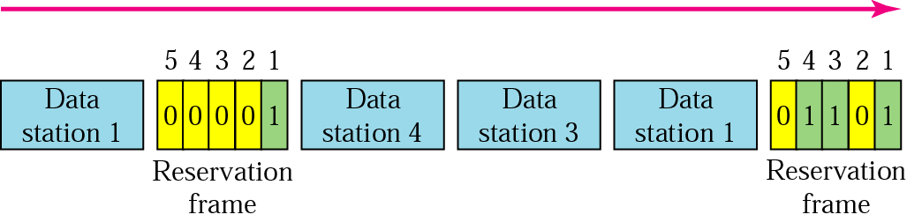
Controlled-Access Protocols
the stations consult one another to find which station has the right to send; a station can not send unless it has been authorized by other stations
Reservation
a station needs to make a reservation before sending data
time is divided into intervals; in each interval, a reservation frame precedes the data frames sent in that interval; if there are N stations in the system, there are exactly N reservation minislots in the reservation frame

Slide 43
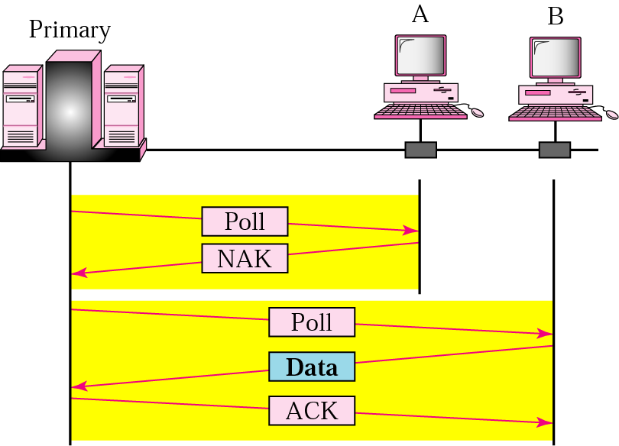
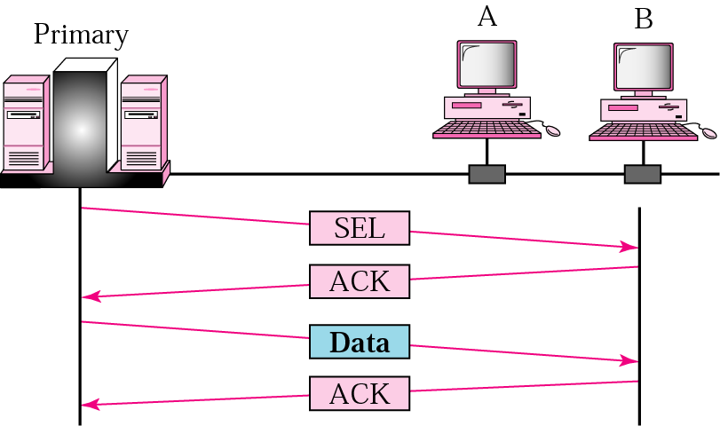
Polling
for topologies in which one device is designated as a primary station and the other stations are secondary stations
the primary asks the secondaries if they have data to send (polling); when it has data to be sent, the primary tells the secondary to get ready to receive (selecting)
a. poll b. select

Slide 44
Token Passing
a station is authorized to send data when it receives a special frame called a token
the stations are arranged around a ring (each station has a predecessor and a successor)
a token circulates around the ring when no data is transmitted
token: a bit sequence
free token: 01111110
busy token: 01111111
when a node wants to transmit
wait for a free token
remove token from ring (replace with busy token)
transmit message
when done transmitting, replace free token on ring

Slide 45
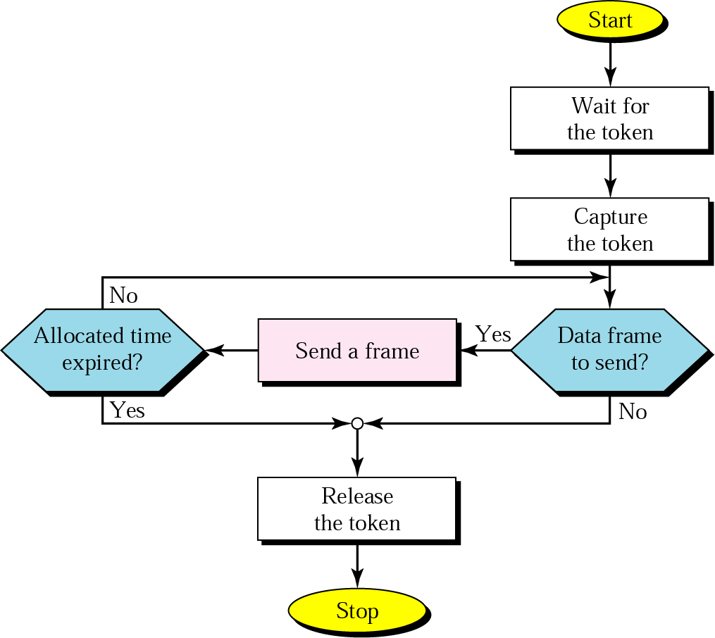
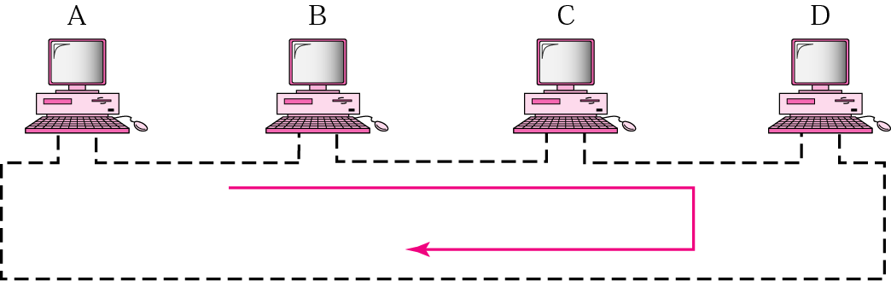
token failures: tokens can be created or destroyed by noise
distributed solution
nodes are allowed to recognize the loss of a token and create a new token
collision occurs when two or more nodes create a new token at the same time ➔ need collision resolution algorithms
node failures: since each node must relay all incoming data, the failure of a single node will disrupt the operation of the ring

Slide 46
example
FDDI - Fiber Distributed Data Interface - is a 100 Mbps fiber optic token ring LAN standard - see later in LANs
it is also used for MANs
Channelization Protocols
the available bandwidth of a link is shared in time, frequency, or through code, between different stations
FDMA - Frequency-Division MA
the available bandwidth is divided into channels; each station uses its allocated band to send its data; each band is reserved for a specific station (it belongs to it all the time)
FDMA is a data link layer protocol that uses FDM at the physical layer
used in cellular telephone and satellite networks

Slide 47
TDMA- Time-Division MA
the entire bandwidth is just one channel; the stations share the capacity of the channel in time; each station is allocated a time slot during which it can send data;
TDMA is a data link layer protocol that uses TDM at the physical layer
also used in cellular telephone
CDMA- Code-Division MA
differs from FDMA because only one channel occupies the entire bandwidth of the link; differs from TDMA because all stations can send data simultaneously (no time sharing)
based on coding theory; proposed several decades ago, but implemented recently due to advances in technology

